Slide 1
Git Branching

Slide 2
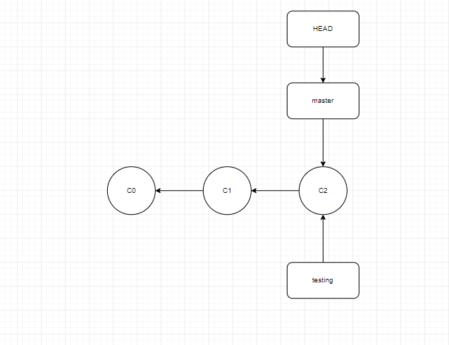
HEAD pointing to a branch

Slide 3
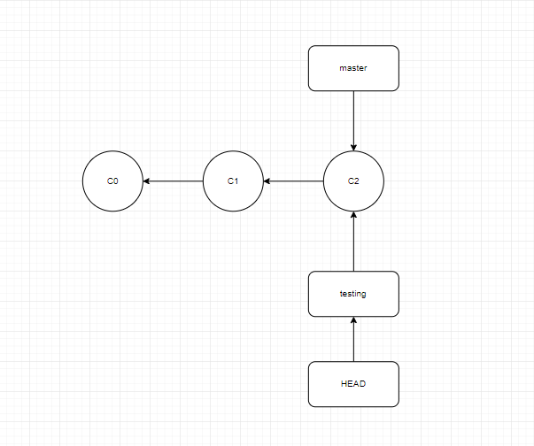
HEAD points to the current branch

Slide 4
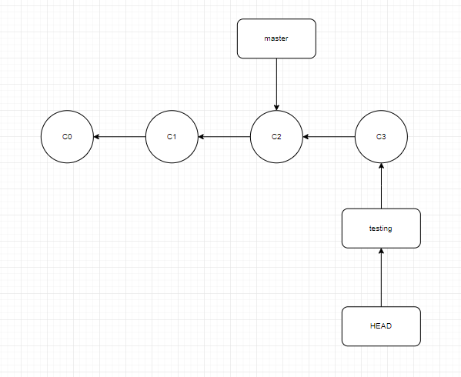
The HEAD branch moves forward when a commit is made

Slide 5
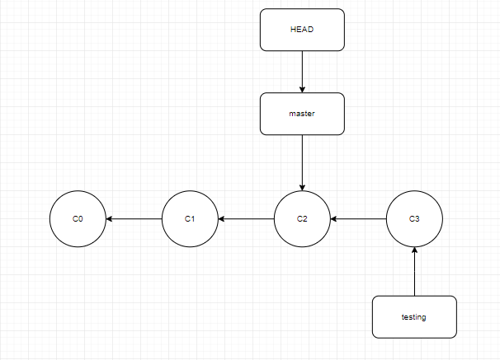
HEAD moves when you checkout

Slide 6
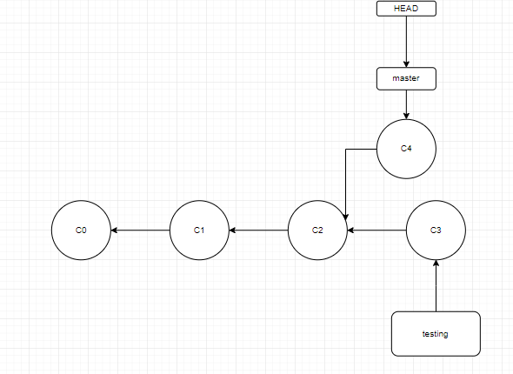
Divergent history

